Slide 1
MODULE 3: Data Types & Table Structure
MySQL

Slide 2
Module 3 - Data Types & Table structures
INT, BIGINT
VARCHAR vs TEXT
DATE, DATETIME, TIMESTAMP
BOOLEAN
NULL vs NOT NULL
DEFAULT values
Choosing correct data types (performance impact)

Slide 3
Introduction to Data Types
A data type defines the type of value that a column can store.
Example values:
Numbers
Text
Dates
Boolean values

Slide 4
Why Data Types Matter (Concept + Demo)
Data types uses:
Storage size
Performance
Data accuracy
Index performance

Slide 5
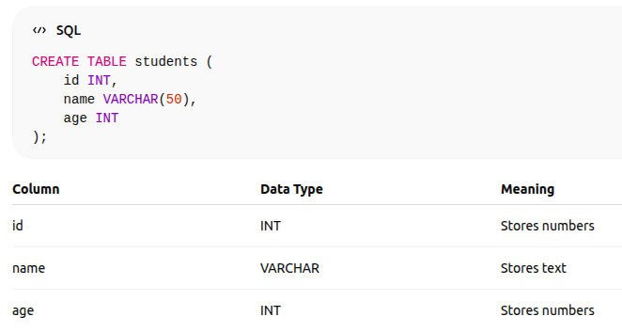
Example

Slide 6
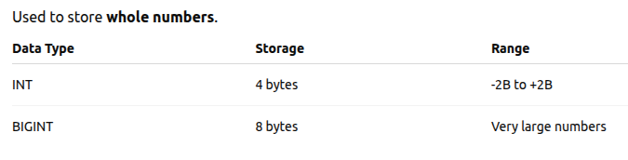
2. INT vs BIGINT

Slide 7
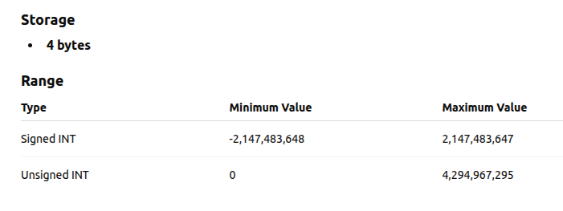
INT (Integer)

Slide 8
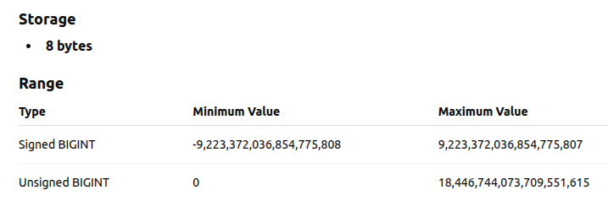
BIGINT

Slide 9
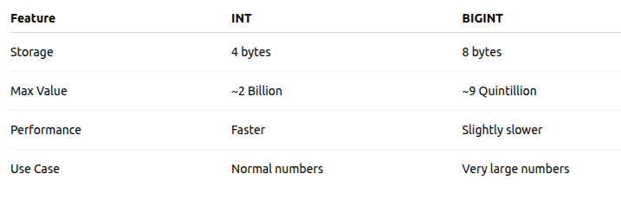

Slide 10
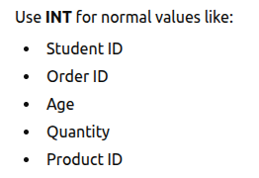
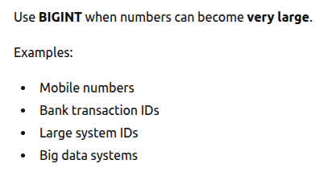
Uses

Slide 11
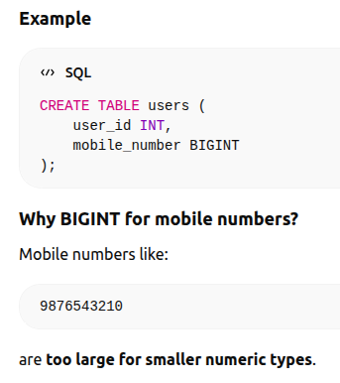

Slide 12
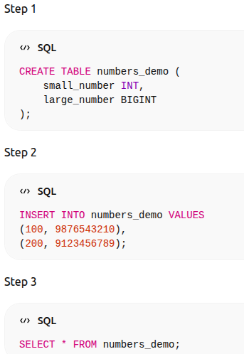
Practical Exercise

Slide 13
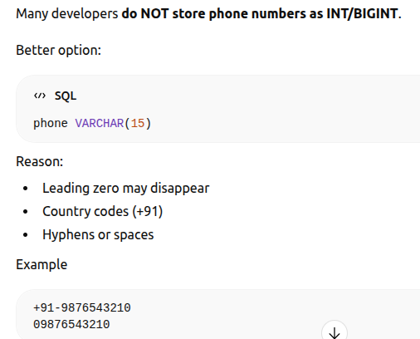

Slide 14
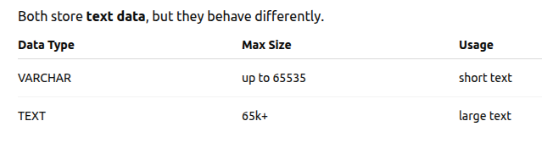
3. VARCHAR vs TEXT

Slide 15
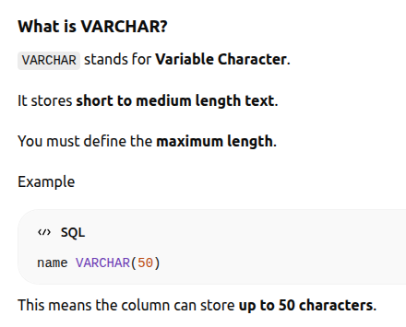

Slide 16
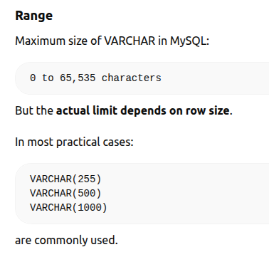

Slide 17
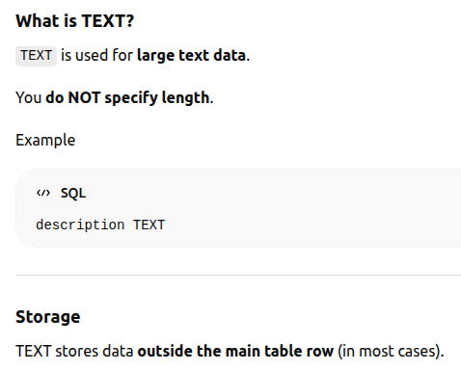

Slide 18
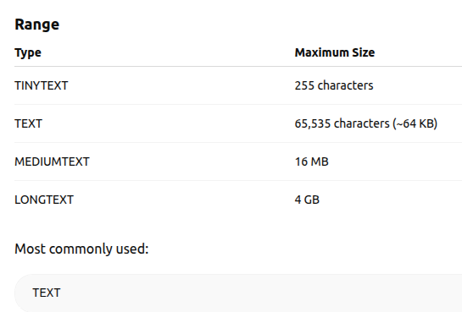

Slide 19
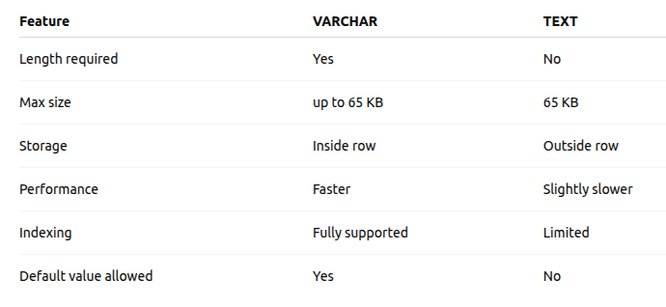

Slide 20
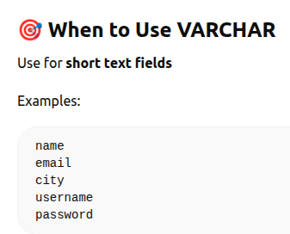
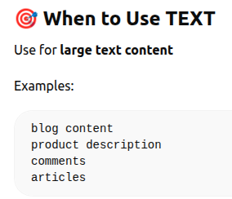
Uses

Slide 21
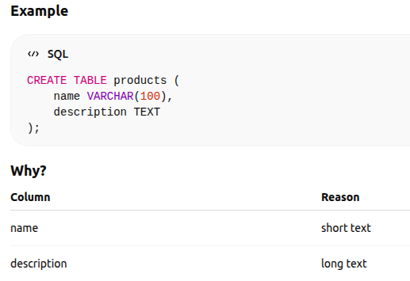

Slide 22
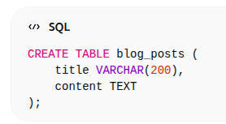
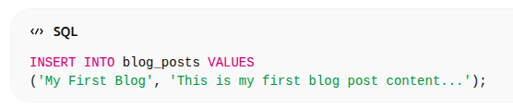

Practical Exercise

Slide 23
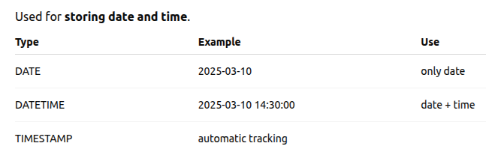
4. DATE vs DATETIME vs TIMESTAMP

Slide 24
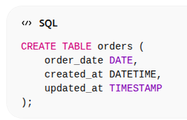
Practical Examples

Slide 25
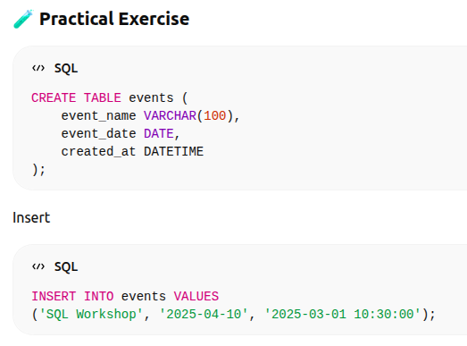

Slide 26
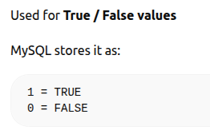
5. BOOLEAN

Slide 27
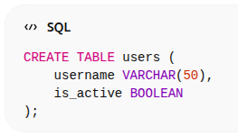
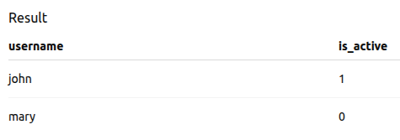
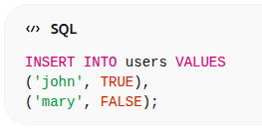
Practical Example

Slide 28
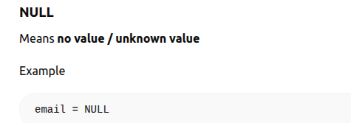
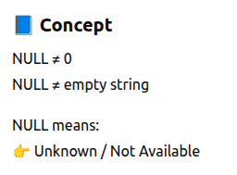
6. NULL vs NOT NULL

Slide 29
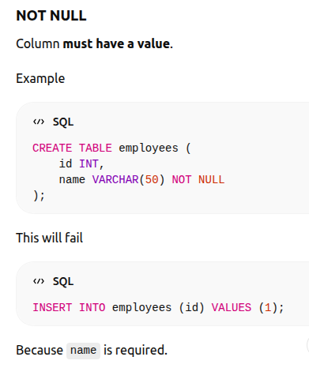

Slide 30
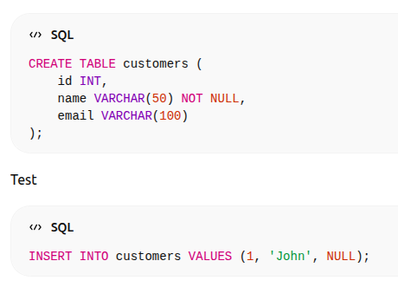
Practical Exercise 1

Slide 31
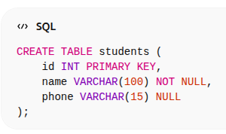
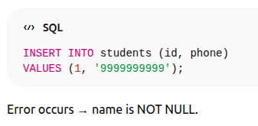
Practical Exercise 2

Slide 32
7. DEFAULT Values
A default value is automatically inserted if no value is provided.

Slide 33
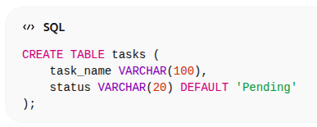
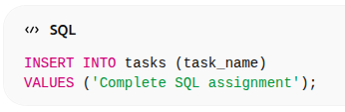
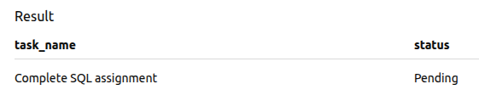
Examples

Slide 34
8. Choosing Correct Data Types (Performance)
Good database design improves:
✔ speed ✔ storage ✔ performance

Slide 35
Data types performance
1. Smaller data type = Faster
INT faster than BIGINT VARCHAR(50) better than VARCHAR(1000)
2. Index Performance
Index on:
INT → Fast
VARCHAR → Slower
TEXT → Heavy

Slide 36
Data types performance
3️⃣ Storage Impact
Example: 1 million rows:
INT (4MB approx) BIGINT (8MB approx)
Double storage = double memory usage

Slide 37
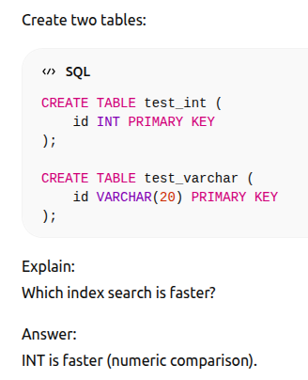

Slide 38
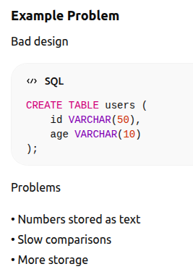
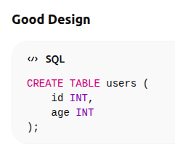

Slide 39
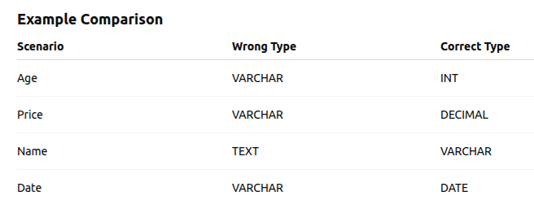

Slide 40
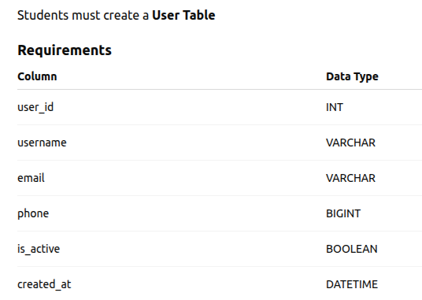
9. Practical Exercise (Mini Practice Task)

Slide 41
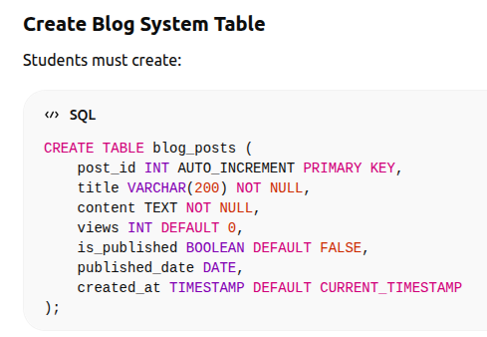
Practical Exercise (Mini Practice Task)

Slide 42
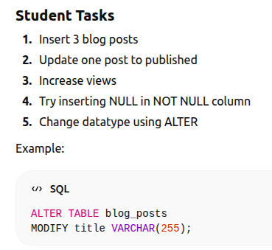

Slide 43
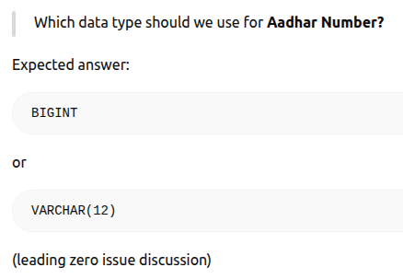

Slide 44
10. MCQ Test

